Slide 1
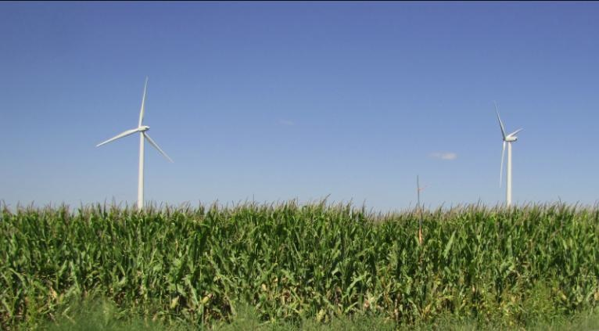
Effect of Wind Turbines on Iowa Crop Production:
Conceptual Framework and Preliminary Results
Eugene S. Takle
Department of Agronomy
Department of Geological and Atmospheric Science
Director, Climate Science Program
Iowa State University
Collaborators: J H Prueger⁴, D A Rajewski^{2,3}, J K Lundquist⁵, M Aitken⁶, M E Rhodes⁷, A J Deppe², F E Goodman⁴, K C Carter², J Hatfield⁴, R Doorenbos¹
¹Agronomy, , ²Geological & Atmospheric Sciences, ³ Ames Laboratory/DOE, Ames, IA
⁴ National Laboratory for Agriculture and the Environment, Ames, IA
⁵ Atmospheric and Oceanic Sciences, ⁶Physics, ⁷ Aerospace Engineering Sciences: University of Colorado, Boulder, CO

Slide 2
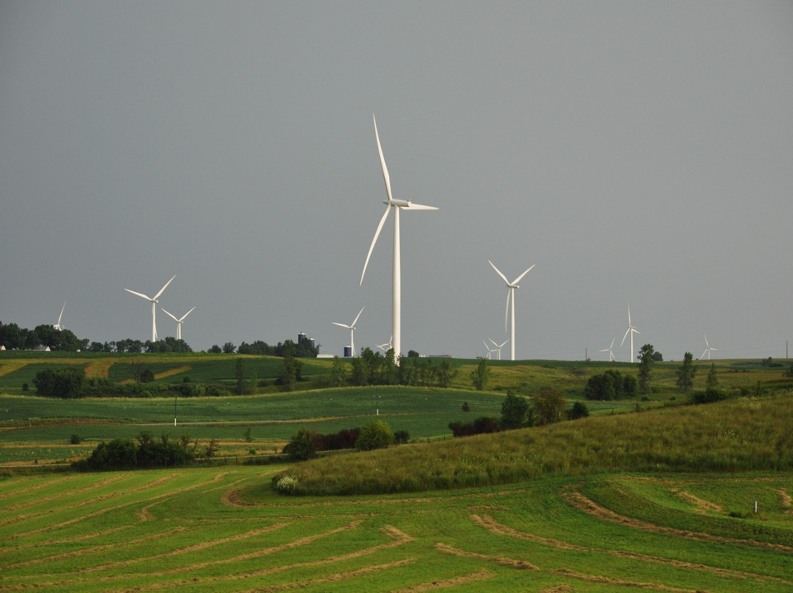
Outline:
Motivation
Conceptual Model
Field Experiment
Preliminary Results
Low-Level Jet
Wind Shear
2011 Field Campaign
Photo courtesy of Lisa H Brasche

Slide 3
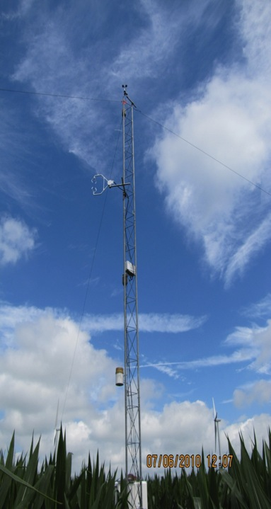
Motivation:
Two Components
Public acceptance of wind turbines
  Multi-use, high-land-value environment
  Crops are tuned to climate conditions
  Do changes in temperature, humidity, wind speed, turbulence, and CO₂ due to wind turbines influence crop growth and yield?
Testbed for validating high-resolution models of wind-farm performance and coupling to surface and PBL
  General understanding of impacts of turbines
  Understand turbine-turbine interaction and wind-farm performance
  Options for further wind farm build-out: Go higher? More dense?
  Iowa has a flat terrain, strong LLJ, not unlike coastal jets, many existing windfarms and component manufacturers: good zero-order testbed for off-shore technologies

Slide 4
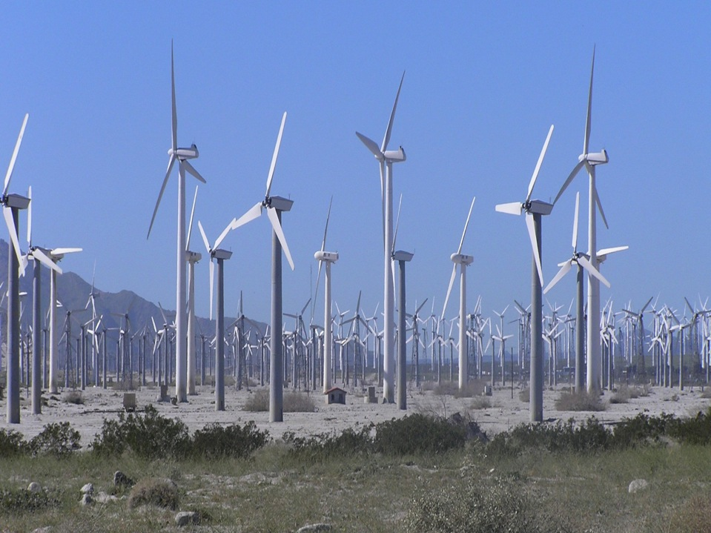
Probably not optimum density for Iowa

Slide 5
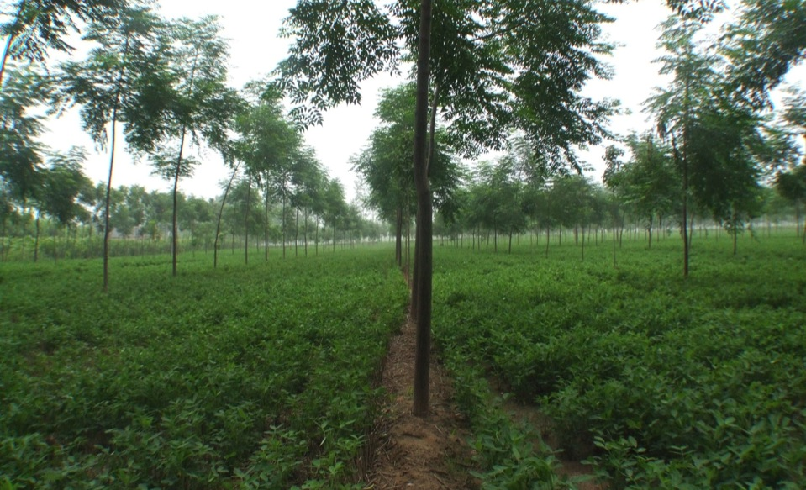
Some Inspiration from China

Slide 6
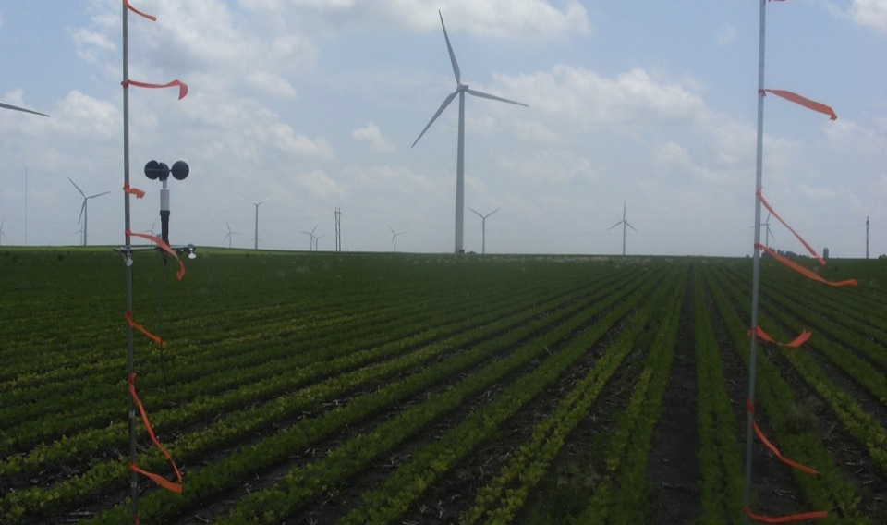
What Turbine Density Optimizes Wind Power Production and Agricultural Production?

Slide 7
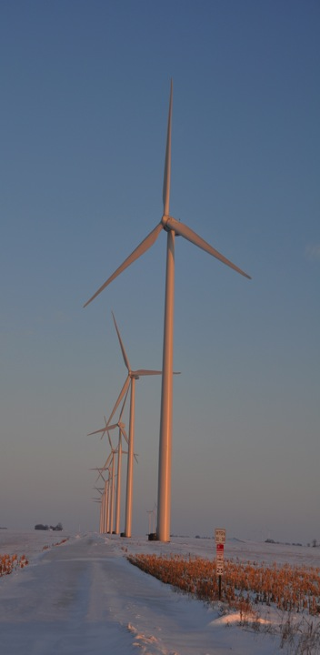
Turbine-Crop Interactions:
Overview
Do turbines create a measureable influence on the microclimate over crops?
If so, is this influence create measureable biophysical changes?
And if this is so, does this influence affect yield?
Agricultural shelterbelts have a positive effect on crop growth and yield.
Will wind turbines also have a positive effect?
Photo courtesy of Lisa H Brasche

Slide 8
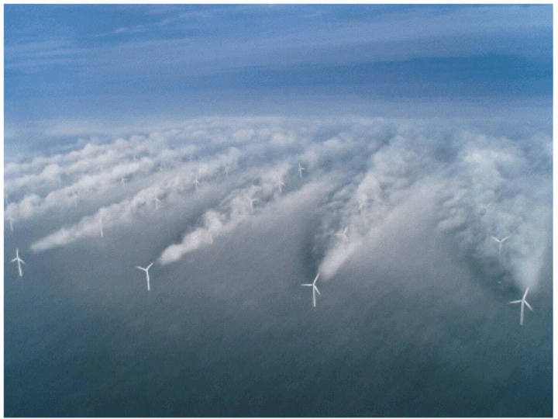
Source: UniFly A/S
Horns Rev 1 owned by Vattenfall. Photographer Christian Steiness.

Slide 9
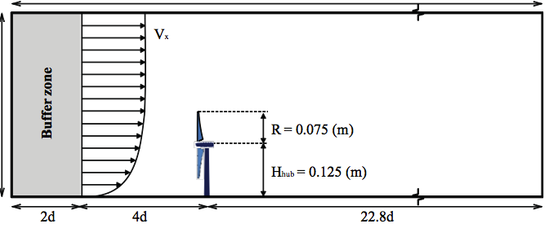
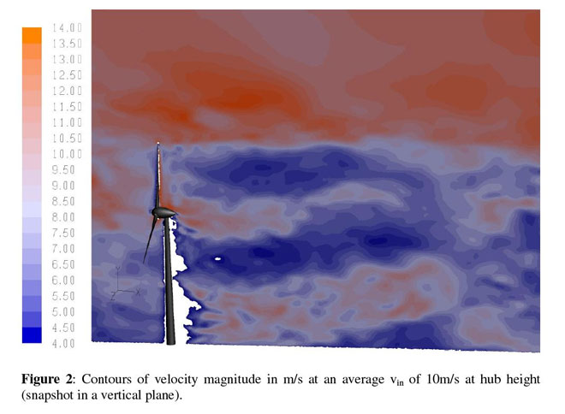
Porté-Agel, Lu, and Wu, 2010
Wuβow, Sitzki, & Hahn, 2007, CFD simulation using ANSYS FLUENT 6.3 LES

Slide 10
Conceptual Model of Turbine-crop Interaction via Mean Wind and Turbulence Fields
Speed recovery
day
H₂O
CO₂
Heat
__ ___________________________________
night

Slide 11
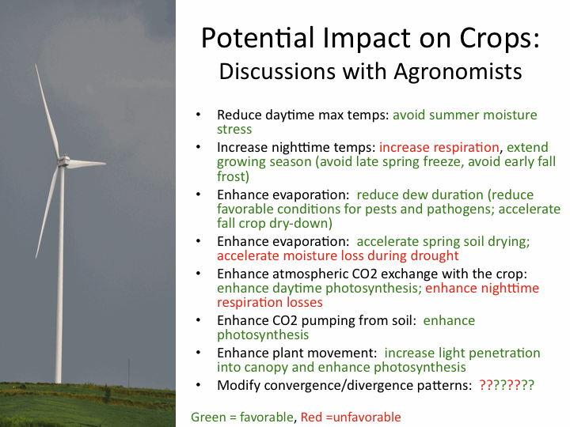
Photo courtesy of Lisa H Brasche

Slide 12
Field Experiment
Central Iowa wind farm (~100 1.3-MW turbines)
Southern edge of a wind farm
Corn-soybean cropping pattern (measurements made in corn)
26 June – 7 September 2010; turbines off 0700 LST 26 July – 2300 LST 5 Aug 2300
4 Eddy Covariance flux towers
NREL/CU Lidar (J. Lundquist) (28 June-9 July)

Slide 13
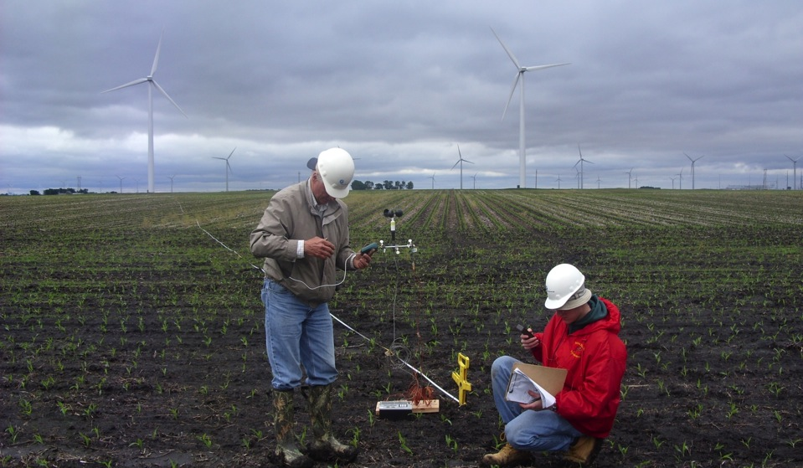
Preliminary Observations

Slide 14

Low-Budget Beginnings

Slide 15
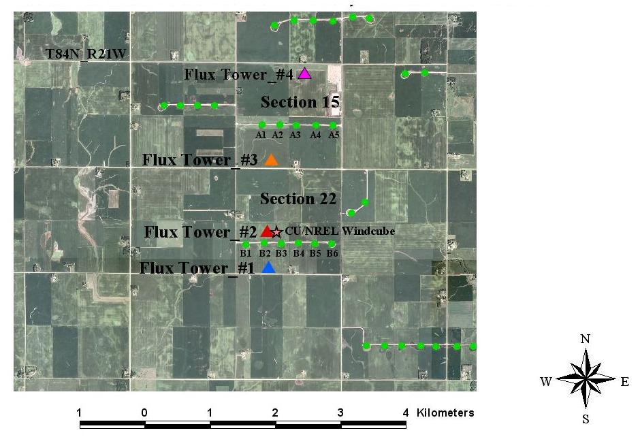
4 flux towers
  maize canopy
  26 June – 7 Sept, 2010
CU/NREL Lidar
  28 June - 9 July 2010

Slide 16
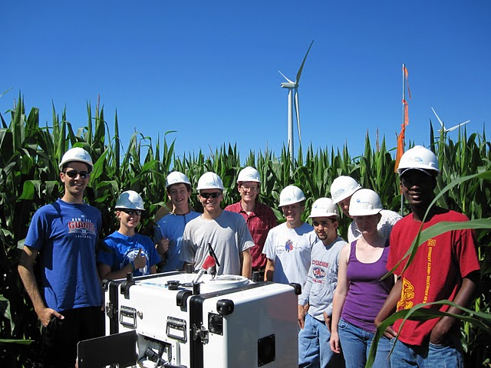

Slide 17
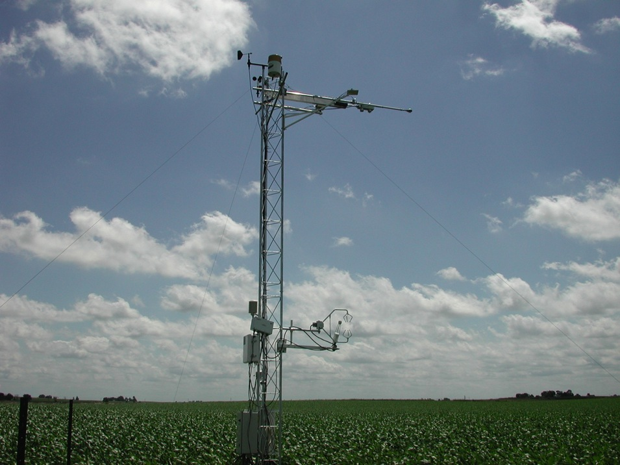

Slide 18
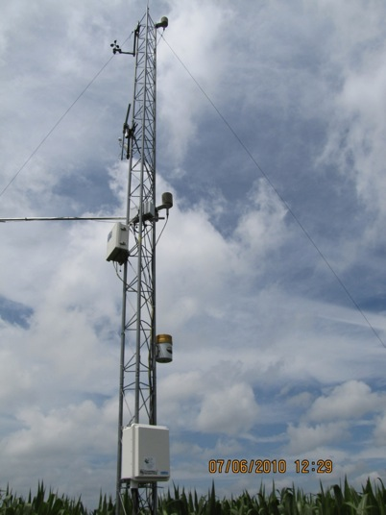
Flux Tower Instrumentation
Each tower
--cup anemometer at 9.1 m
-- T & RH at 9.1 m and 5.3 m
--sonic anemometer at 6.45 m
---tipping bucket at 3.75 m
Two towers (reference and near-wake location)
--Net radiometer
--Open path CO2/H20 IRGA LI-7500
Sonic anemometer and Li-7500 sampled at 20 Hz w/ 5 min averages
T, RH, cup anemometer, rain gage output archived at 5 min

Slide 19
Data analysis
Focus on ‘differences’ in crop microclimate at flux tower locations
Pay attention to wind direction
Turbines on – turbines off
Isolate instrument and location biases
  Reference sonic temperature ~ 0.6-0.8ºC high
  possible influence from localized advection (large pond and wet field 1 km SE of the reference tower)

Slide 20
Wind speed comparison at 9 m
Preliminary
South wind: Turbines On
NW wind: Turbines On
South wind: Turbines Off
NW wind: Turbines Off

Slide 21
Wind speed comparison at 9 m
Preliminary
South wind: Turbines On
NW wind: Turbines On
Daytime wind speed decrease
South wind: Turbines Off
NW wind: Turbines Off

Slide 22
Normalized TKE comparison at 6 m
Preliminary
South wind: Turbines On
NW wind: Turbines On
More turbulence at night
South wind: Turbines Off
NW wind: Turbines Off

Slide 23
u’w’ comparison at 6 m
Preliminary
South wind: Turbines On
NW wind: Turbines On
Higher nighttime surface stress
South wind: Turbines Off
NW wind: Turbines Off

Slide 24
Air temperature comparison at 9 m
Preliminary
South wind: Turbines On
NW wind: Turbines On
Cooler during day, warmer at night
?
South wind: Turbines Off
NW wind: Turbines Off

Slide 25
Carbon flux w’CO₂’ around peak LAI
Preliminary
NW W NW W SW
W SW W SW S SE
Higher carbon uptake by crop behind turbines
Higher nighttime respiration behind turbines
9 Jul
10 Jul
10 Jul
11 Jul

Slide 26
Summary
Preliminary analysis seemed to show a measureable influence of turbines on microclimate over crops.
However
More in-depth analysis (wavelets, spectral analysis), more days of observation, different overall wind conditions shows more inconsistencies
Not sure that preliminary measurements represent general conditions

Slide 27

The dynamics of the lower atmosphere are complex, especially at night
Radiosonde profiles demonstrate that the cooling of the surface overnight is accompanied by dramatic accelerations in the winds
1800 LST
2200 LST
0200 LST
0800 LST
1800 LST
2200 LST
0200 LST
0800 LST
Height above surface [m]
Height above surface [m]
Wind Speed [ms⁻¹]
Potential Temperature [K]
Poulos, Blumen,
Fritts, Lundquist, et al.,
2002
Julie.Lundquist@nrel.gov
Notes:
As the atmosphere stabilizes over a cold surface, winds accelerate into a jet structure with significant shear on the underside, generating turbulence

Slide 28
Models Don’t Capture Height of Jet Max
Data courtesy of K. Carter and Adam Deppe, ISU
Observations
Models

Slide 29
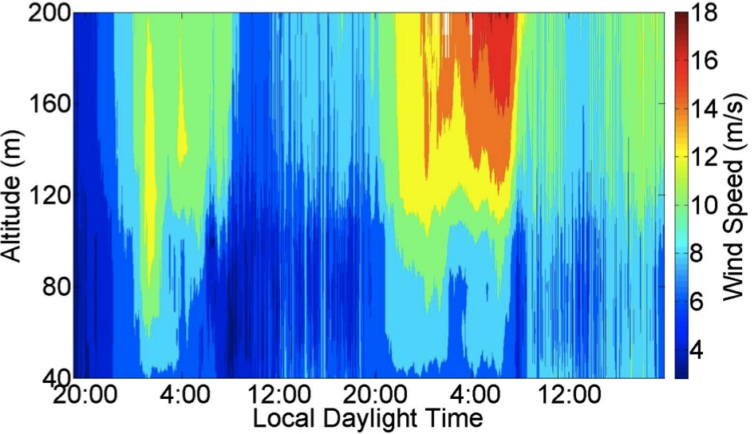
Observed wind speed profiles (Windcube lidar, summer, midwest US) exhibit more variability than is traditionally considered in CFD
LLJ Max
~ 16 m/s
And these are “typical” midwestern conditions!
LLJ Max
~ 12 m/s
Turbine Wake
Rhodes, Aitken, Lundquist, 2010, 2011
Julie.Lundquist@colorado.edu

Slide 30
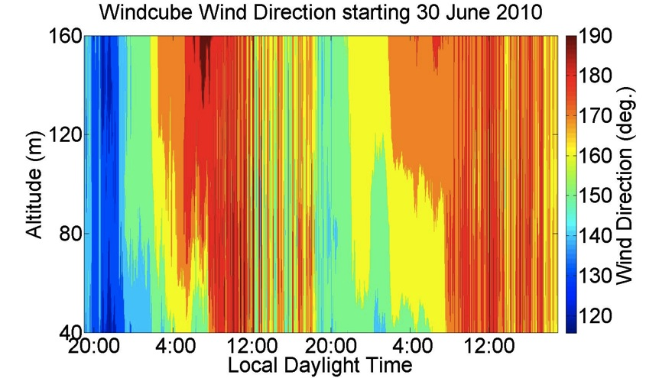
Directional shear of 20 degrees across the rotor disk is common
Considerable nocturnal directional shear
And these are “typical” midwestern conditions!
Rhodes, Aitken, Lundquist, 2010, 2011
Julie.Lundquist@colorado.edu

Slide 31
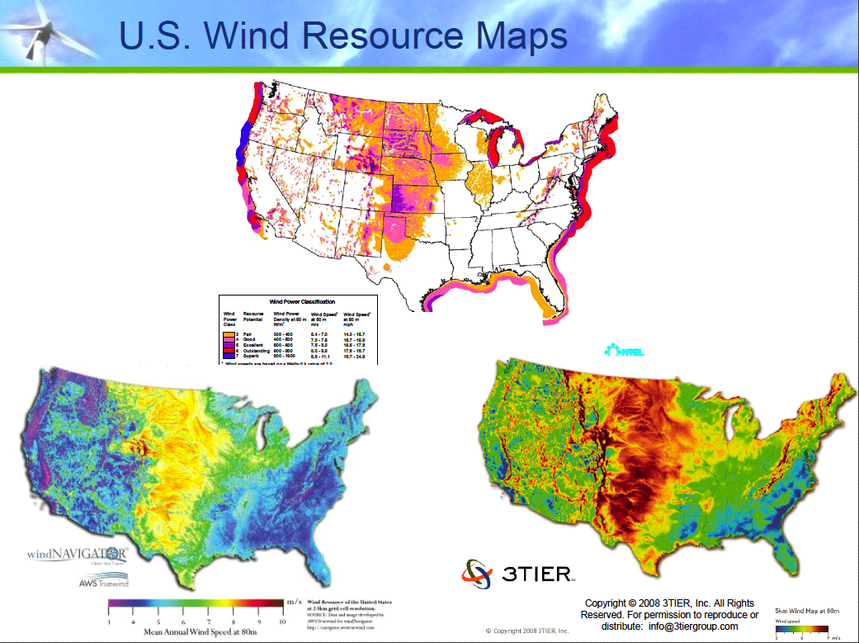
How valid are
these off-shore
estimates?
It is much easier and
less expensive to validate
and improve models at
on-shore sites

Slide 32
2011 Field Campaign
Same location
Measure from June-August
Six measurement stations (instead of 4); four provided by National Center for Atmospheric Research
Two lidars (one upwind, one downwind)
Wind Energy Science, Engineering and Policy Research Experience for Undergraduates: 10 openings, 260 applicants, 34 states, 70 women, 12 with 4.00 GPA.
With such interest from young people wind energy has a bright future in Iowa!

Slide 33
Summary
We have fragmented evidence that turbines under some conditions are measurably influencing surface fluxes
Under overall weather conditions of 2010 we have no reason to expect a negative impact of turbines on crops, and there may be a positive effect
The 2011 field campaign will include more instruments and sensor placement to better observe turbine influences

Slide 34
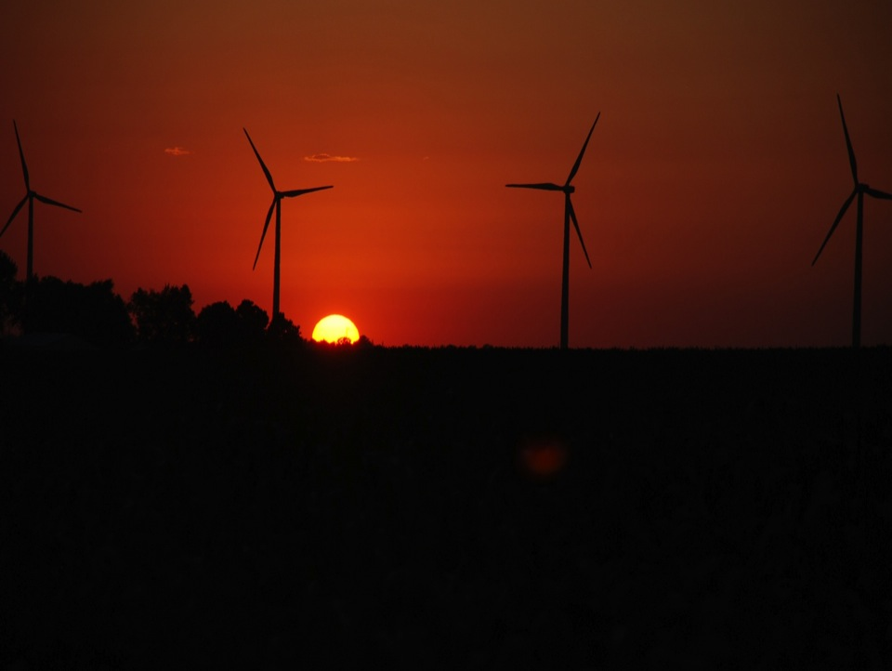
ACKNOWLEDGMENTS
Julie Lundquist for slides from presentation at LANL
Dr. Ron Huhn, property owner
Gene and Todd Flynn, farm operators
Lisa Brasche for photos
Equipment and personnel supplied by the National Laboratory for Agriculture and
the Environment
Funding supplied by
Center for Global and Regional Environmental Research, University of Iowa
MidAmerican Energy Company
Ames Laboratory , Department of Energy
National Science Foundation
Photo courtesy of Lisa H Brasche

Slide 35
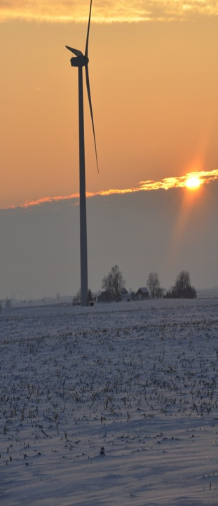
For More Information
Eugene S. Takle
gstakle@iastate.edu
http://www.meteor.iastate.edu/faculty/takle/
515-294-9871
Julie K. Lundquist
Julie.Lundquist@colorado.edu
Julie.Lundquist@nrel.gov
http://atoc.colorado.edu/~jlundqui
303/492-8932 (@CU)
303/384-7046 (@NWTC)
Photo courtesy of Lisa H Brasche

